Slide 1

Case Study- Type 2 Hypervisor Section – B
Group no – 6 Vanshika, Siddhartha Urvashi, rashmita

Slide 2
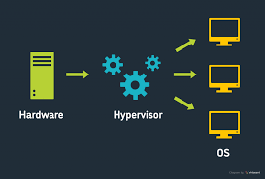
A hypervisor is a form of virtualization software used in Cloud hosting to divide and allocate the resources on various pieces of hardware.
The program which provides partitioning, isolation, or abstraction is called a virtualization hypervisor.
The hypervisor is a hardware virtualization technique that allows multiple guest operating systems (OS) to run on a single host system at the same time.
A hypervisor is sometimes also called a virtual machine manager(VMM)

Slide 3
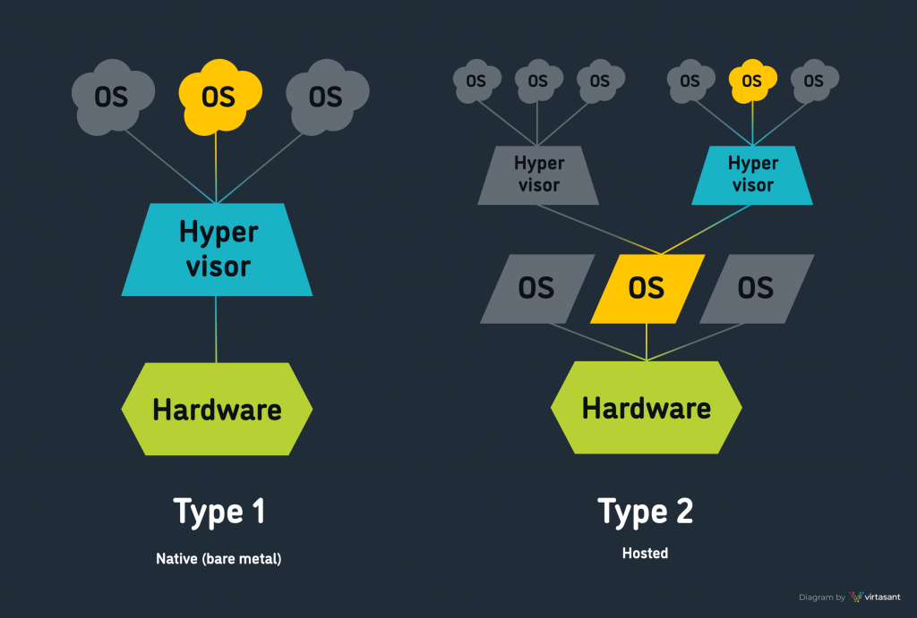
Type 1
Type 1 hypervisors run directly on the host machine hardware, eliminating the need for an underlying operating system (OS). They are usually used in data centers, on high-performance server hardware designed to run many VMs. Type 1 hypervisors offer better performance as they run directly on the underlying hardware and do not rely on the host’s OS.
Type 2
Type 2 hypervisors are installed and run on a conventional operating system like any other computer application. They are usually deployed on desktop computers and workstations to run a different OS or to run a separate instance of an OS. Popular type 2 hypervisors:
VMware Workstation, Oracle VirtualBox, Parallels Desktop.

Slide 4
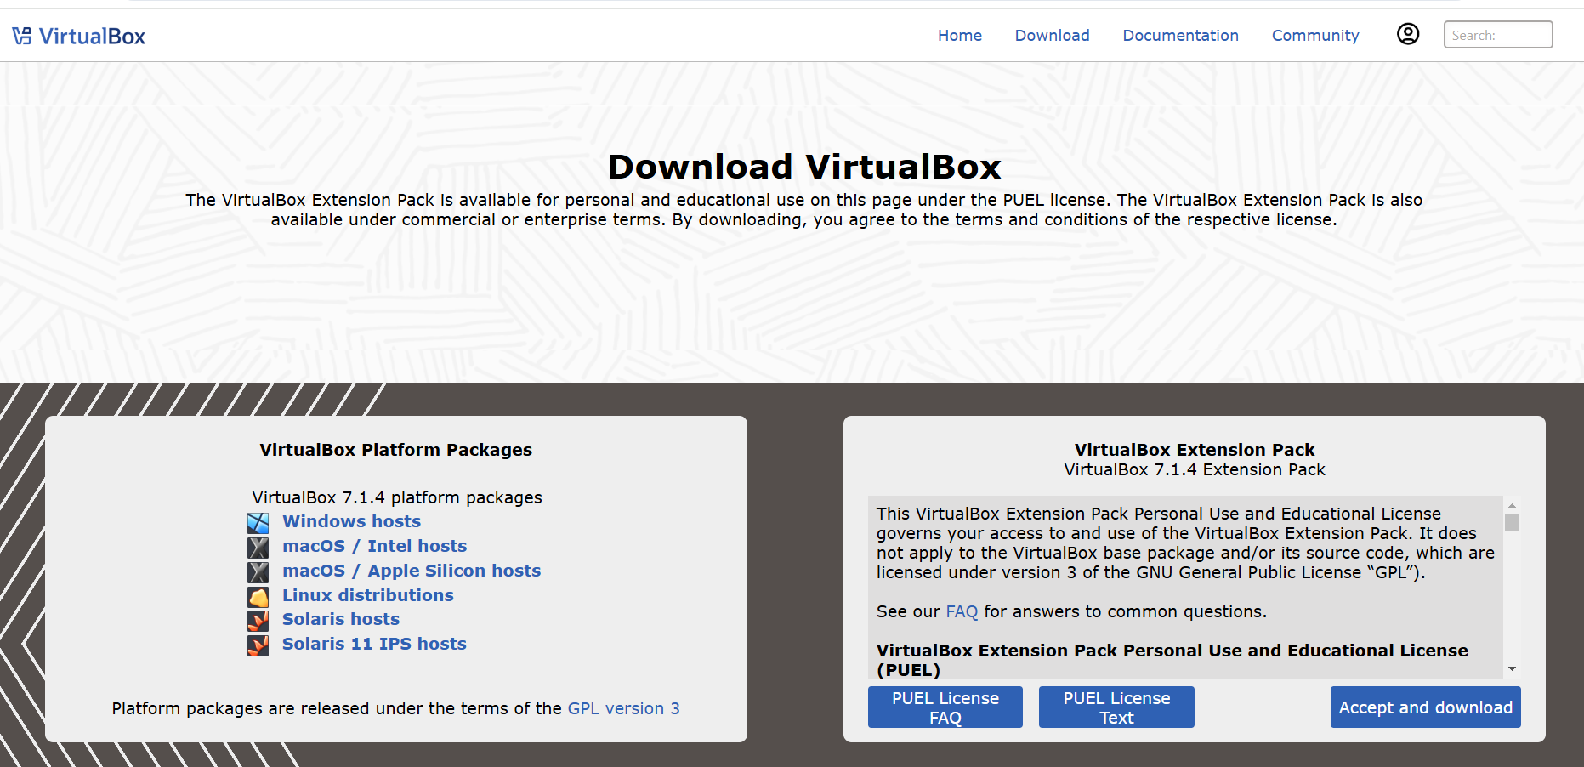
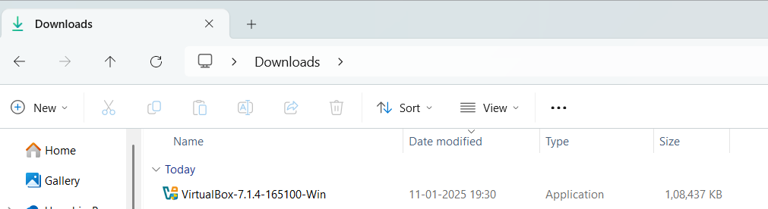
Download and install virtual box
Click here then download
Go to file location where you downloaded and click.

Slide 5
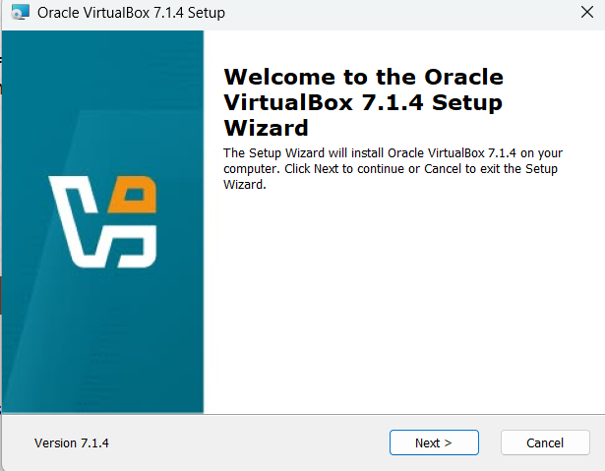
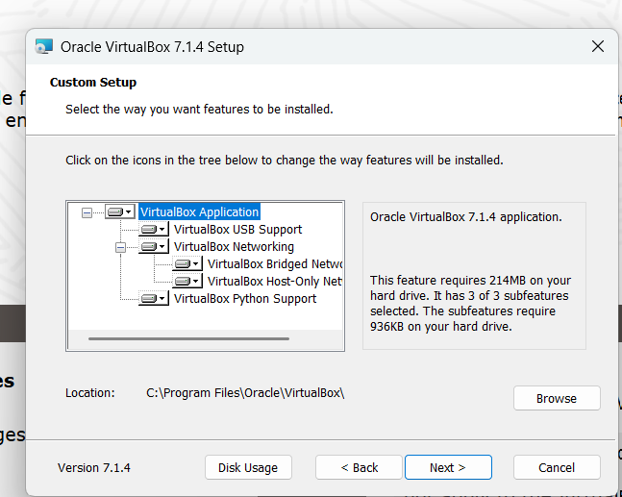
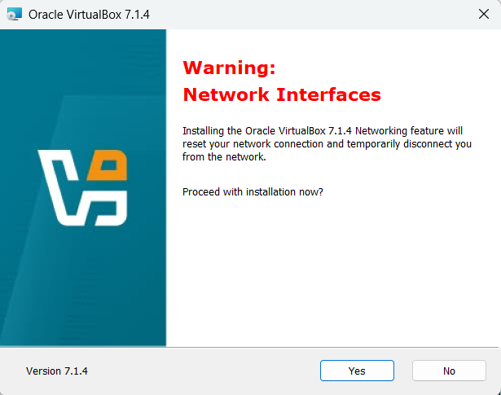
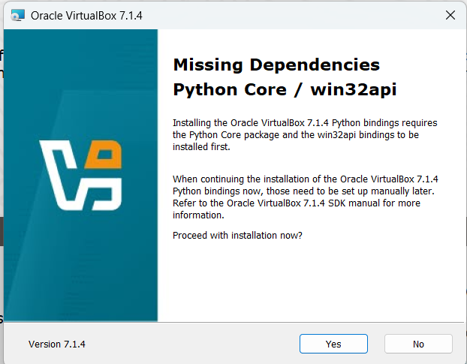

Slide 6
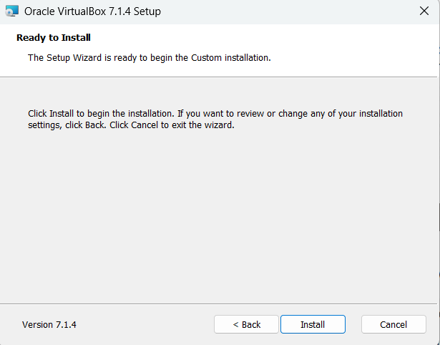
This image shows that setup wizard is ready to install.
Click on Install

Slide 7
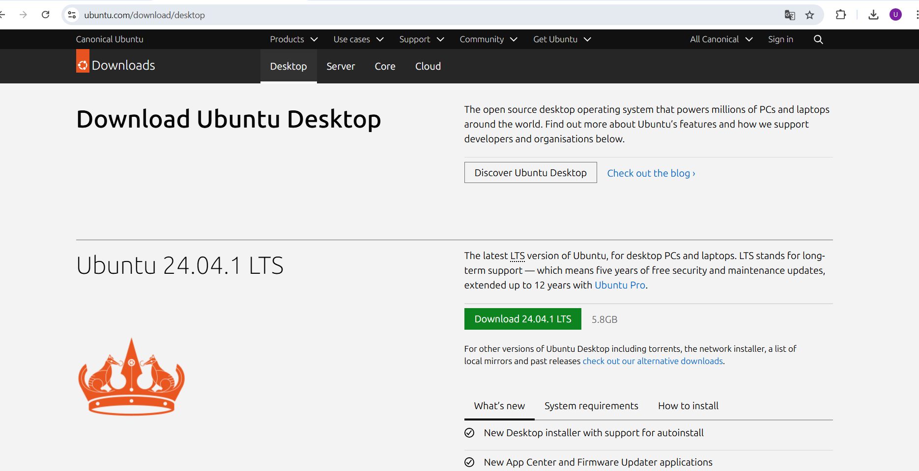
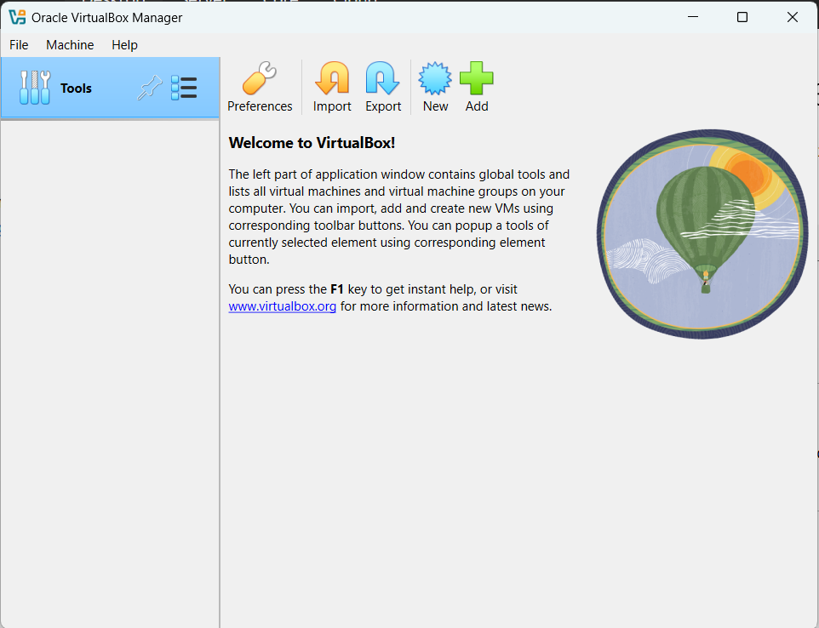
Download Ubuntu from- www.ubuntu.com/download/desktop
Open virtual box.
Click on machine and then new.

Slide 8
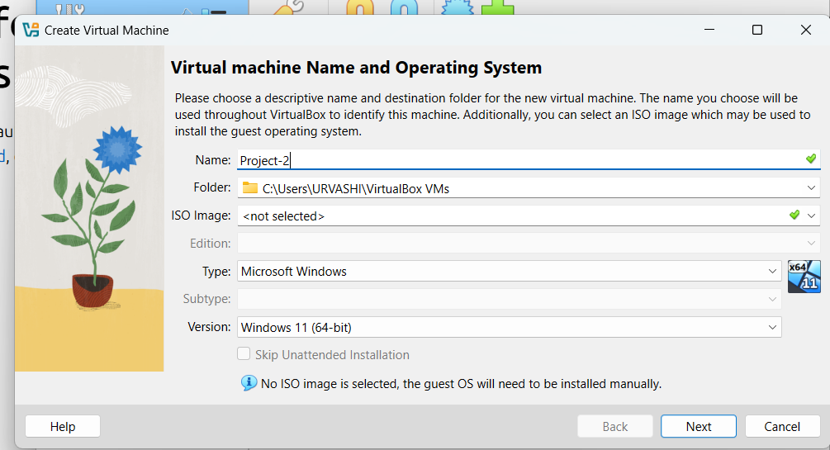
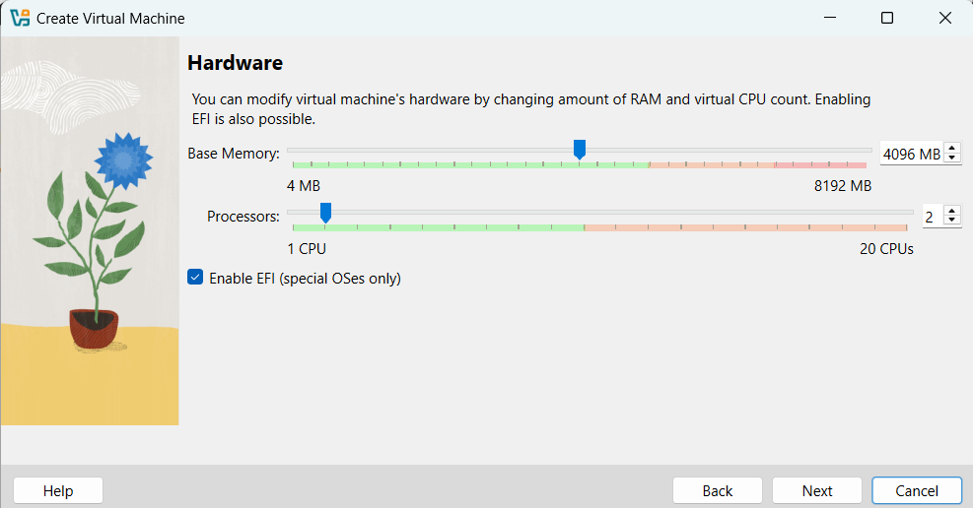
Setting up new virtual machine.
Giving name.
Specifying how much memory(RAM) and how many virtual CPUs will virtual machine have.

Slide 9
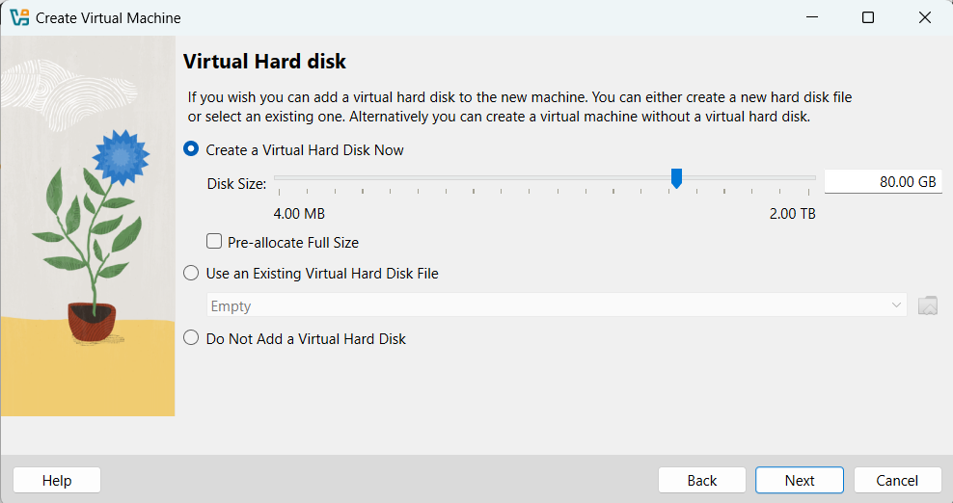
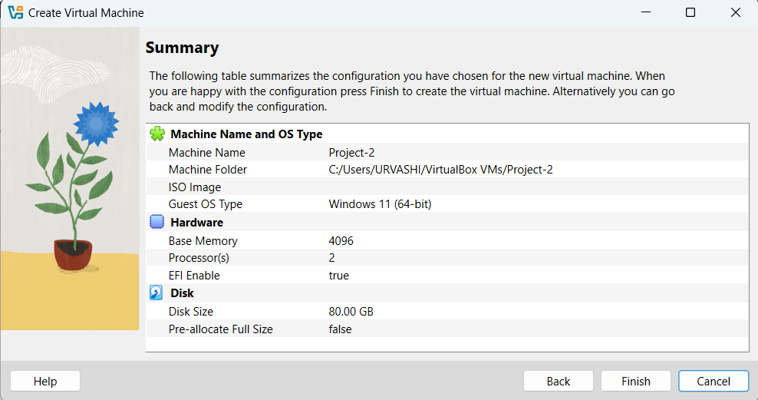
In the window, user is choosing how to add a virtual hard disk for new virtual machine.
Summary screen of new virtual machine configuration windows in VirtualBox.
Click on finish button to create virtual machine.

Slide 10
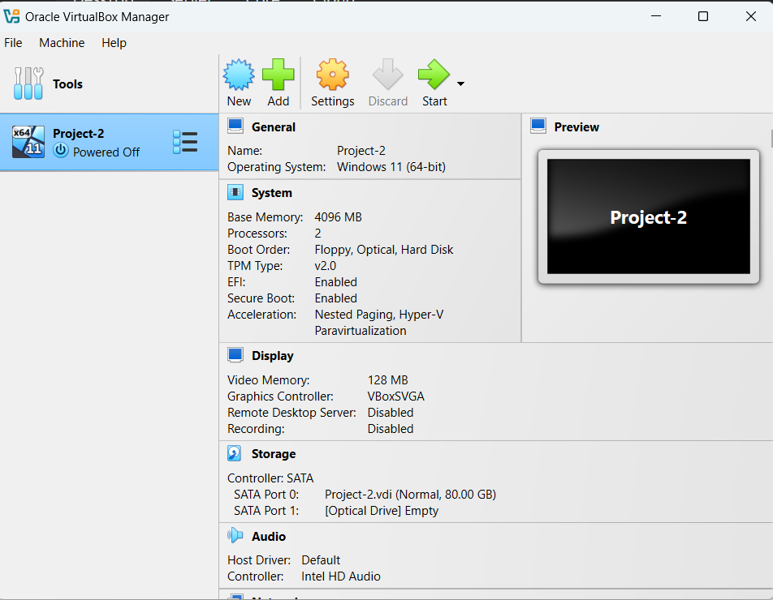
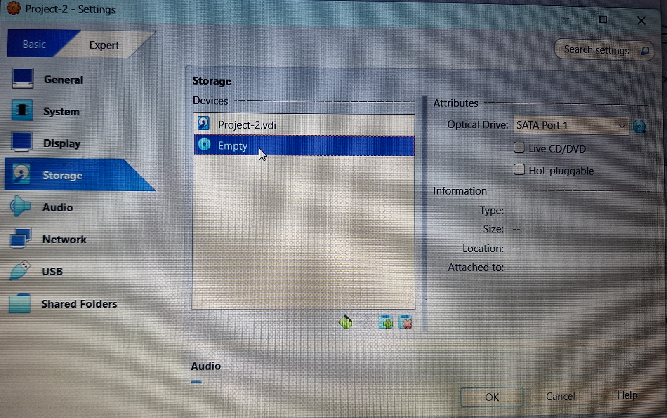
Now we must add ubuntu so Click on settings.
Click here
Go to Storage, here we can see that it is showing empty.

Slide 11
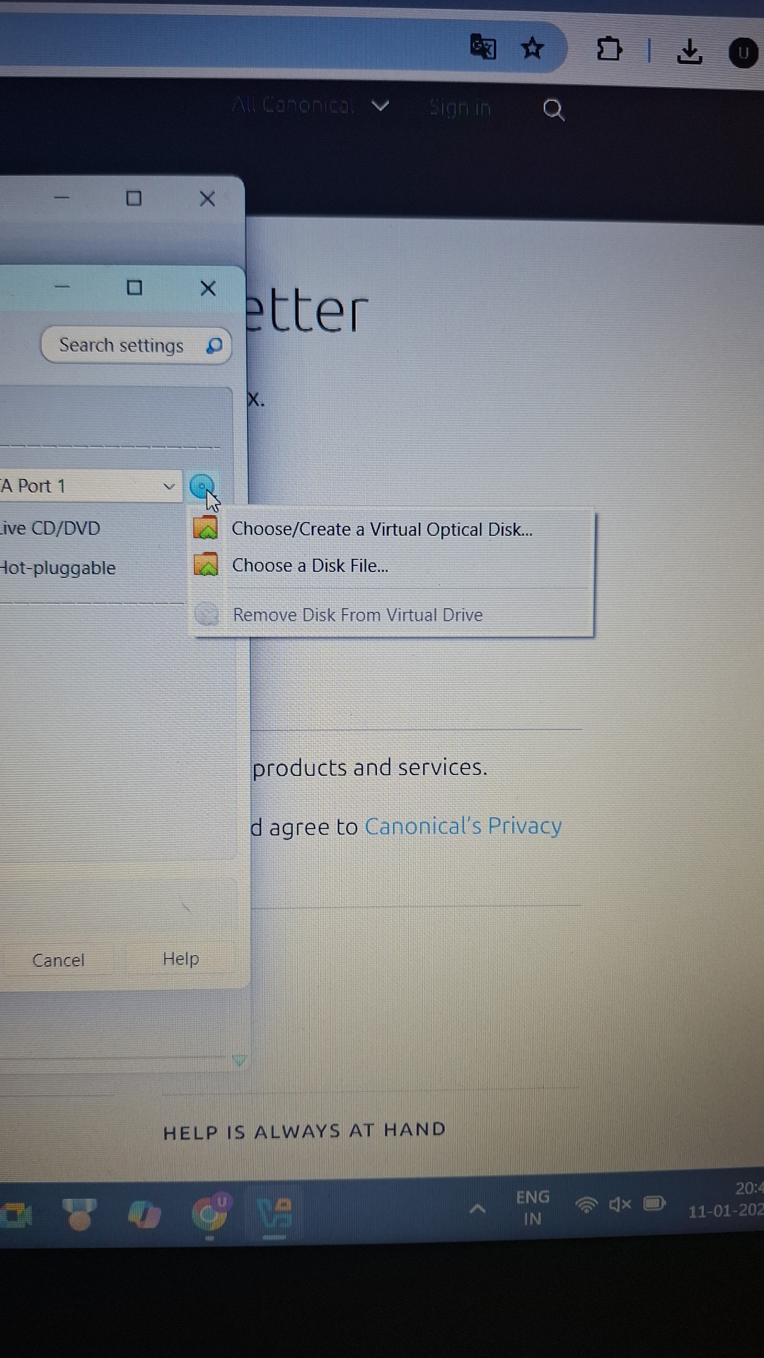
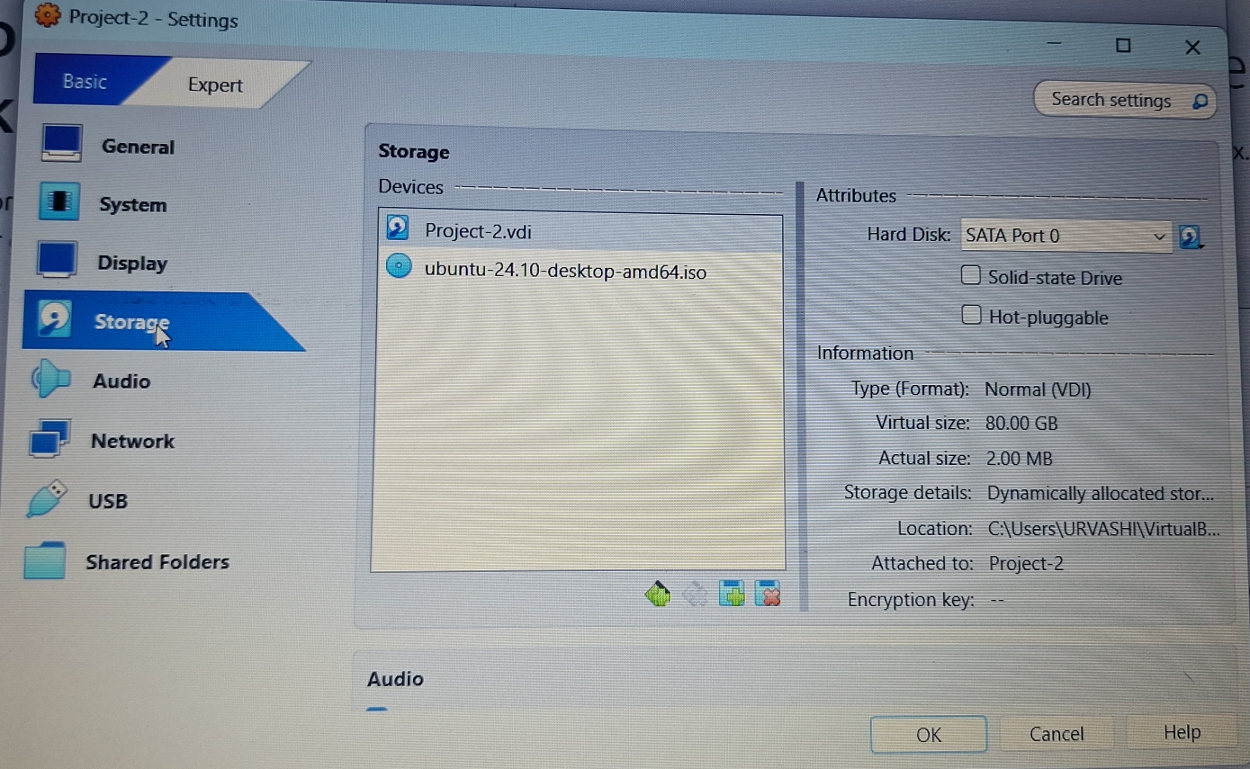
As soon as we click, we get two options from this we will select choose a disk file. Then we will go to location where ubuntu is downloaded and add it.
Here we can see that ubuntu is added. Now we click on ok.

Slide 12
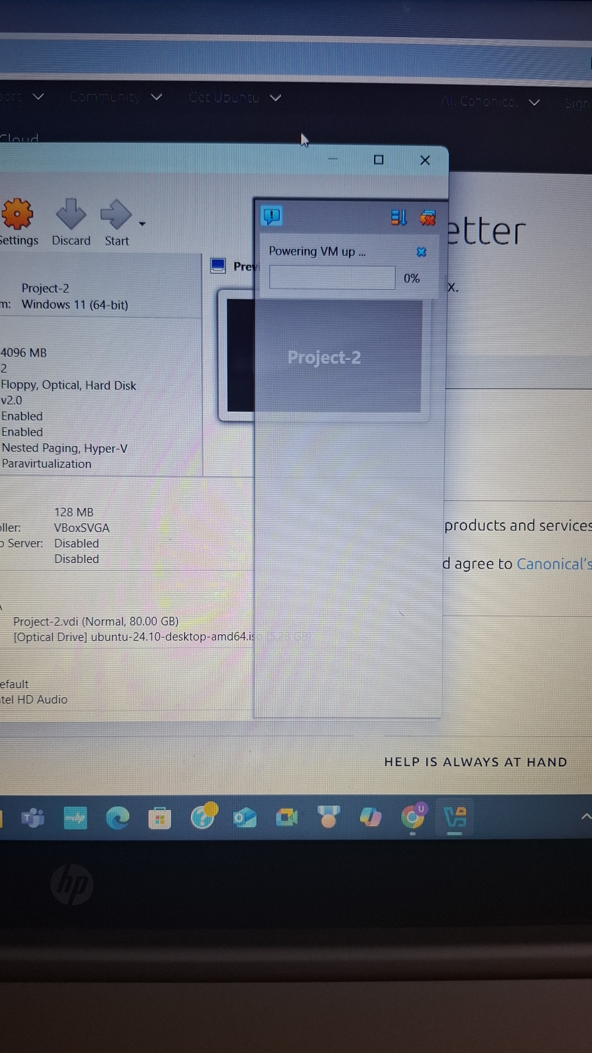
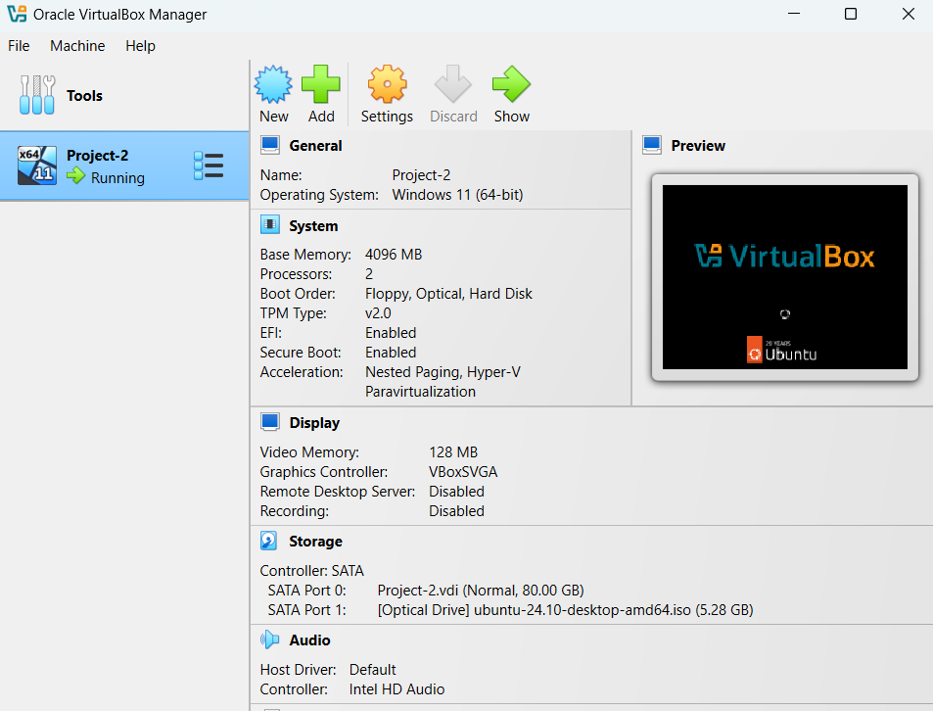
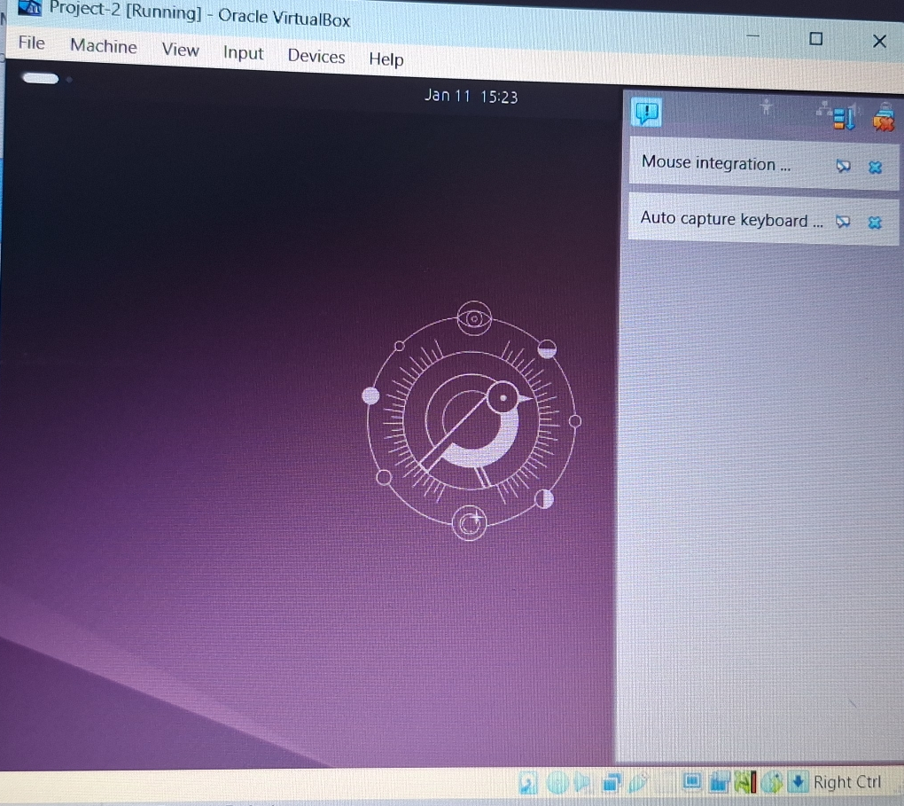
Once done we will click on show.
We can see here that vm is getting powered.
We can see the screen and on right we will select auto capture keyboard.

Slide 13
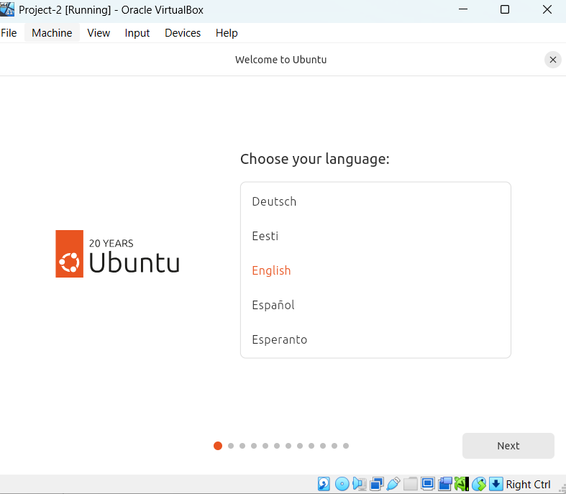
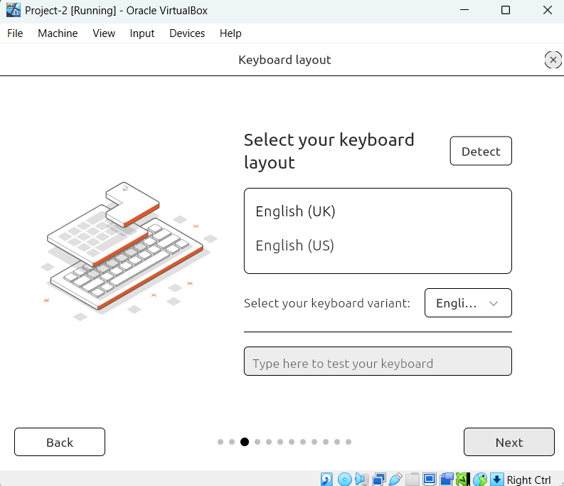
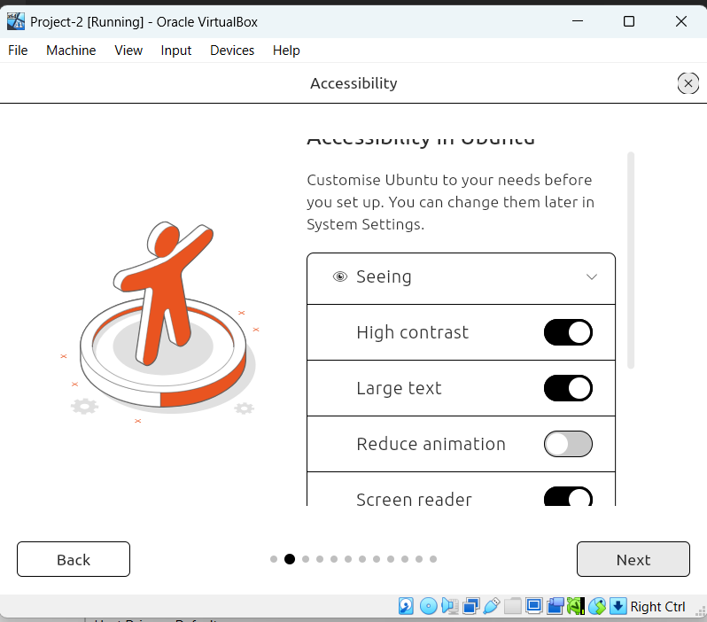
This are different setting of ubuntu which we will select such as which language etc.

Slide 14
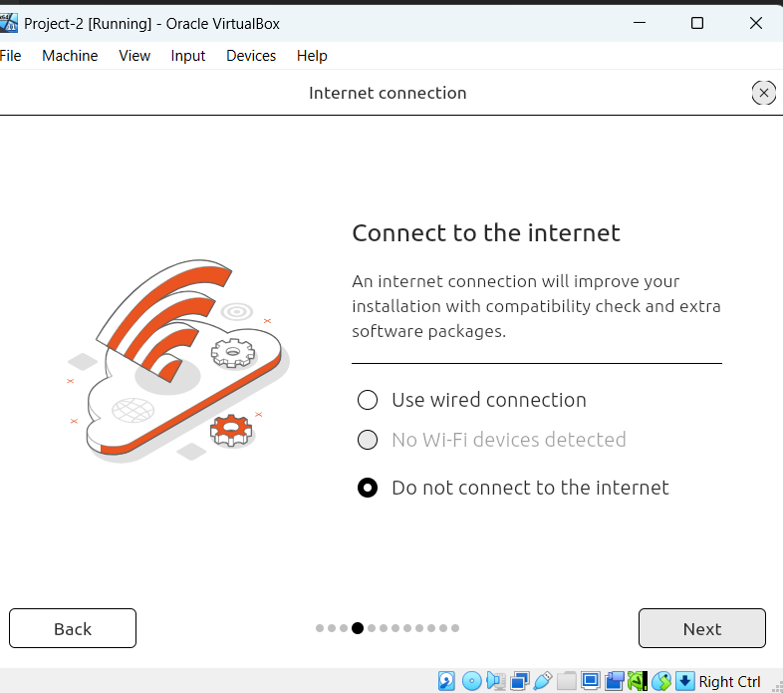
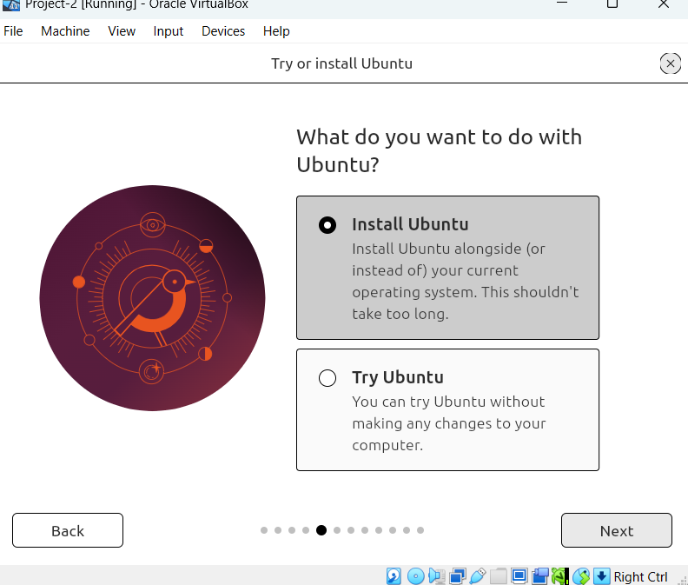
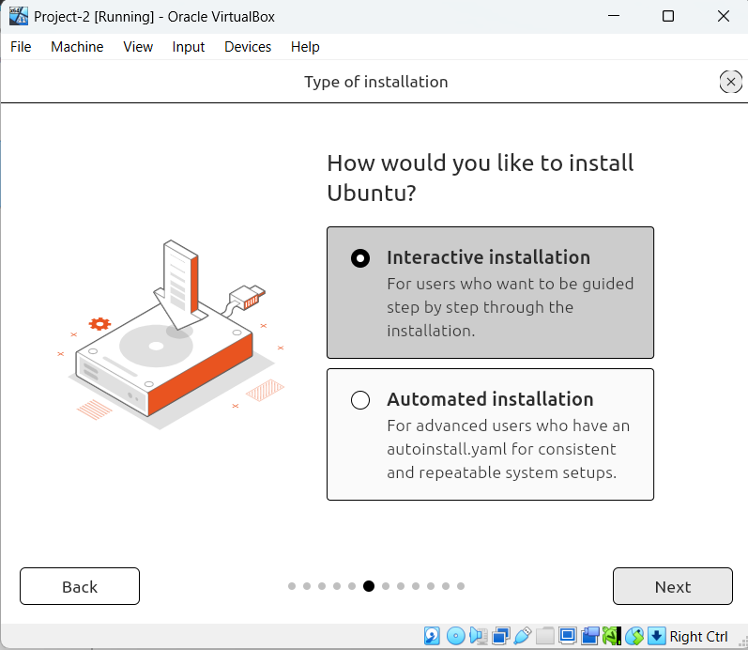
Some more setting which we to select and then click on next every time.

Slide 15
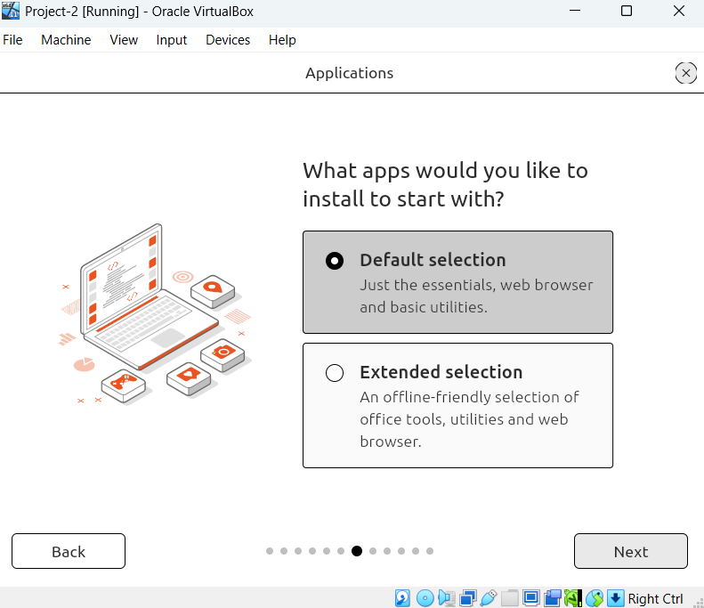
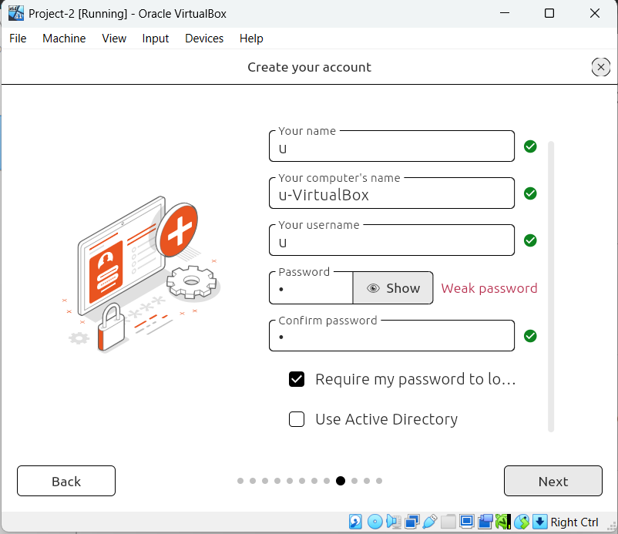
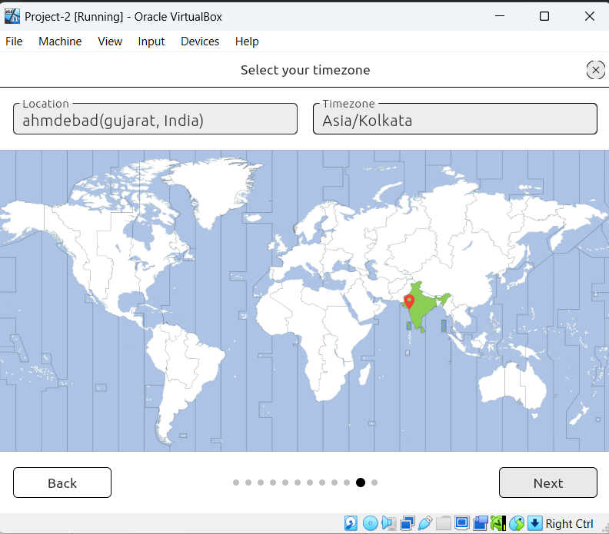
Here we have selected which apps we want, then created account and selected time zone in this case Ahmedabad.

Slide 16
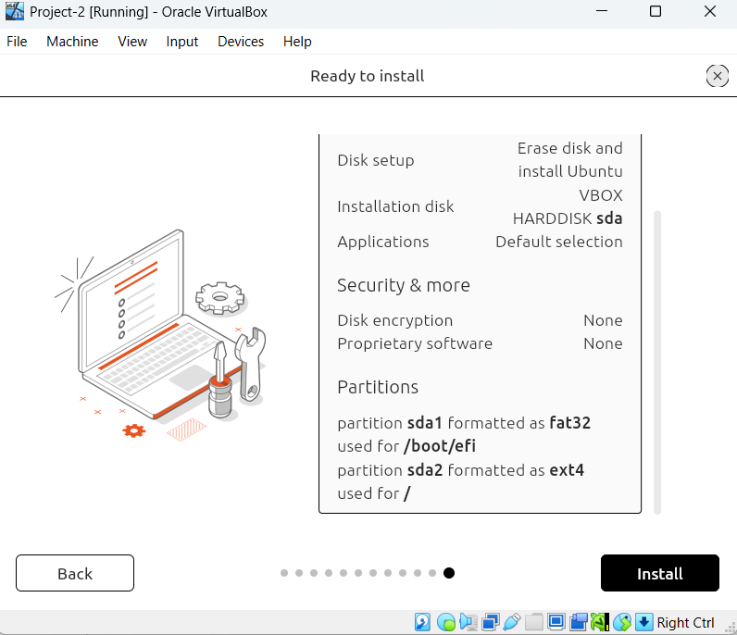
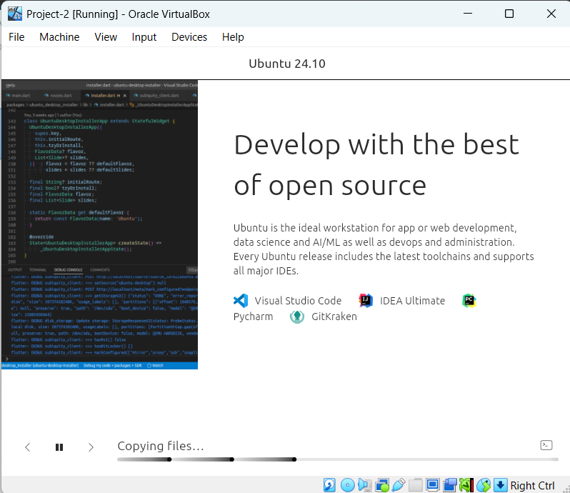
Last step where we just click on install and on right, we can see that it is copying files.

Slide 17
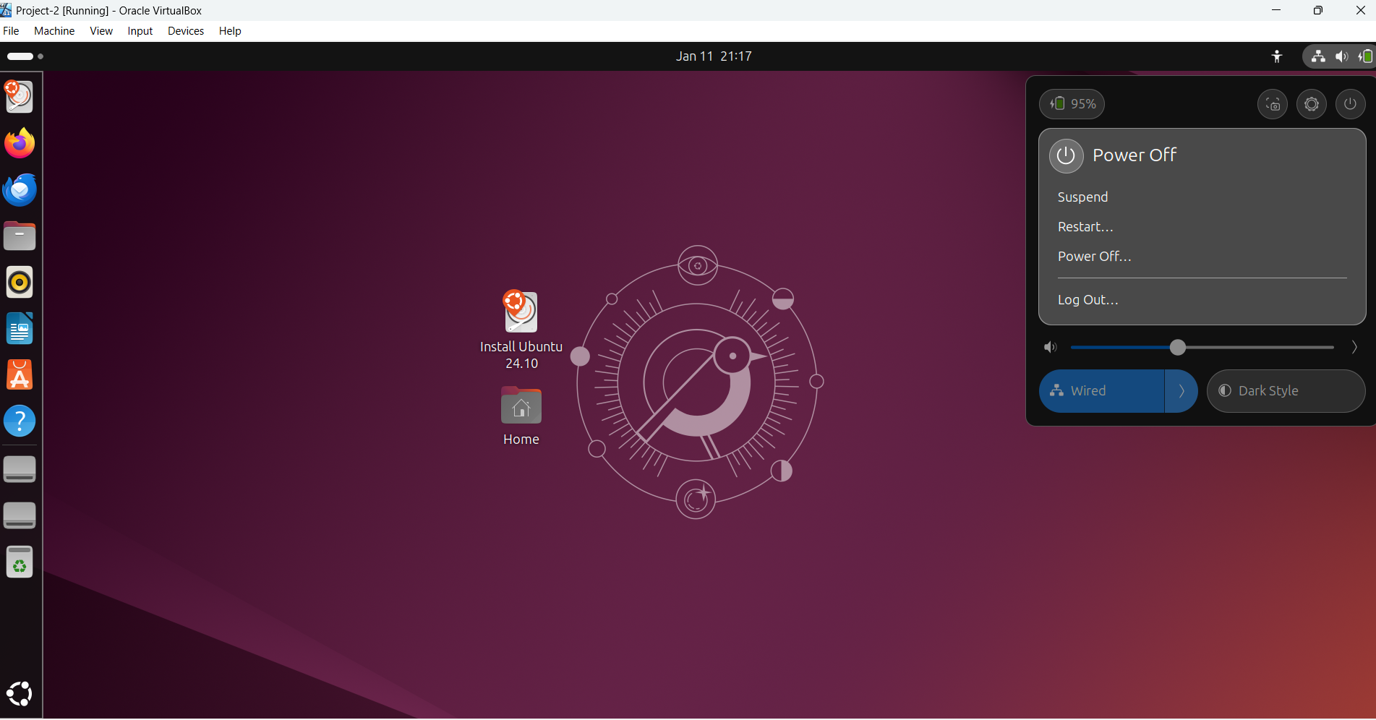
Here it started with default apps and on right there is options to power off.
We can start this again by clicking on virtual box application.

Slide 18
Thank You

